Slide 1
Introduction to Circuit Playground
Adapted from materials by Crystal Hess

Slide 2
Learning Goals
What is Circuit Playground?
What is an embedded system?
How to make an LED blink on an Circuit Playground
How to make an LED fade on an Circuit Playground
Vocab: Circuit Playground board, LEDs, compiling a program, uploading a program, digital vs analog

Slide 3
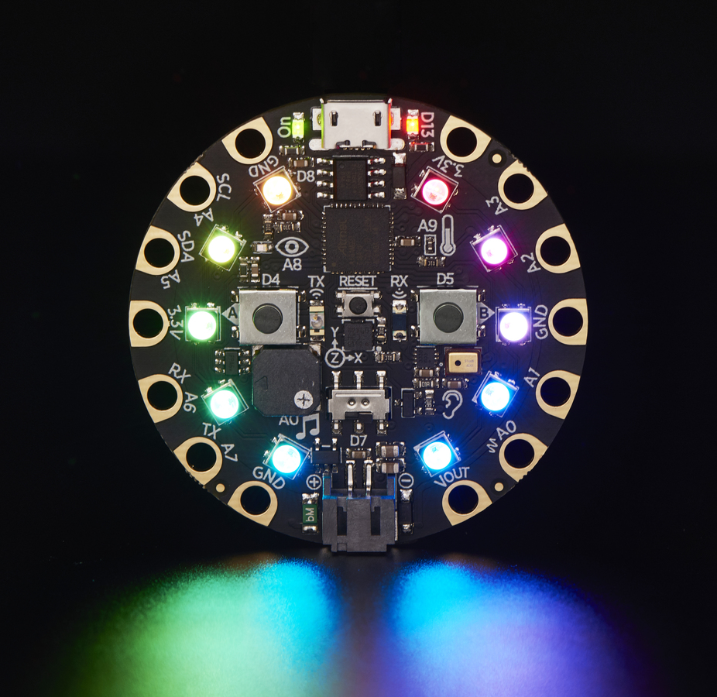
What is a Circuit Playground?
A small computer on a single chip
containing a processor, memory, and input/output
Typically "embedded" inside some device that it controls
Small and low cost

Slide 4
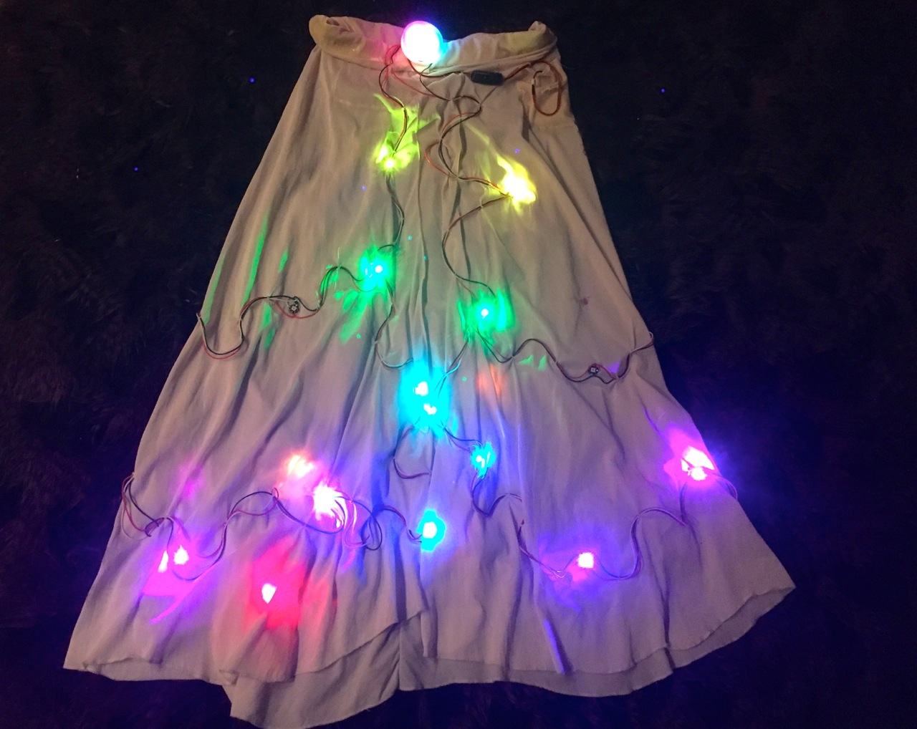
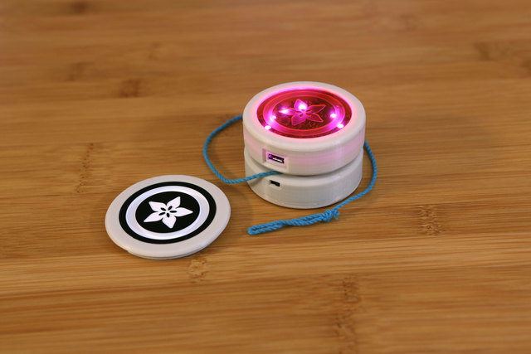

Slide 5
What is an Embedded System?
An embedded system is a computer system with a dedicated function within a larger mechanical or electrical system, often with real-time computing constraints.
It is embedded as part of a complete device often including hardware and mechanical parts.
Embedded systems control many devices in common use today.

Slide 6
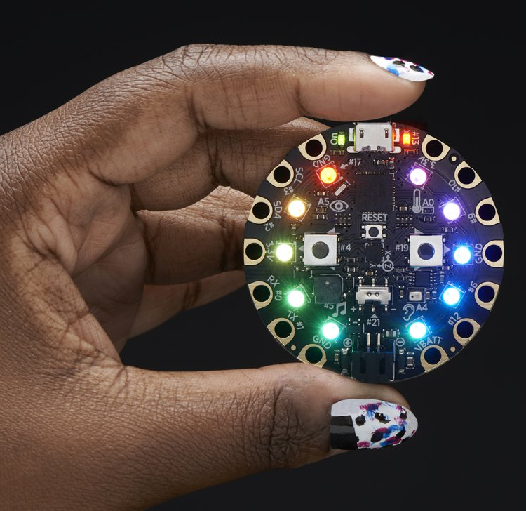
Get your own (if you want)
Hardware ~ around $20
Circuit Playground Classic
https://www.adafruit.com/product/3000
Software ~ free
Download at https://learn.adafruit.com/circuit-playground-lesson-number-0/install-software-windows

Slide 7
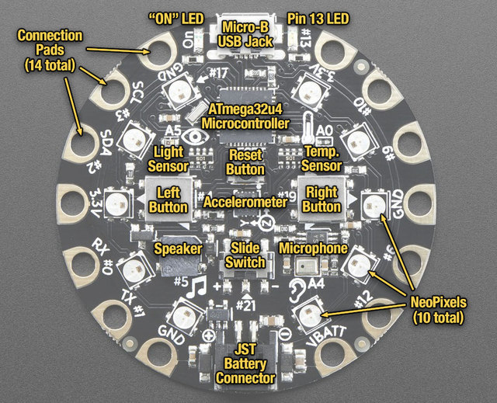
Layout

Slide 8
Blink Example

Slide 9
Example: Blink
Hardware
Circuit Playground board
USB cable
Computer w/ internet browser
Software
Launch the Arduino Web IDE
Make an account
Select your board
Connect the C.P.
Open the example Basics → Blink
Upload the program

Slide 10
Play with the Code
What does digitalWrite do? delay?
What happens if you put // (forward slash, forward slash) in front of a line of code?
What happens if you change pinMode(LED_BUILTIN, OUTPUT) to say pinMode(13,OUTPUT)? What about pinMode(9,OUTPUT)?

Slide 11
Circuit Playground Library
Access unique parts of Circuit Playground with their own library.
https://caternuson.github.io/Adafruit_CircuitPlayground/

Slide 12
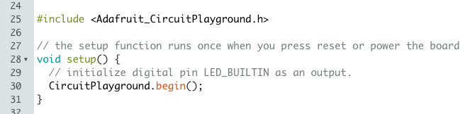
Including the C.P. Library
Add the line with “#include” somewhere near the top of your file
Call “CircuitPlayground.begin()” in setup()
What are the “()” doing?
Full Documentation: https://caternuson.github.io/Adafruit_CircuitPlayground/

Slide 13
Learning the Library
Rewrite the Blink program to instead use a NeoPixel instead
What lines need to change?
What lines don’t need to change?
How do you know what commands to use?

Slide 14
Fade Example

Slide 15
Example: Fade
Software
Open the example Basics → Fade
Upload the program

Slide 16
Play with the Code
What happens when you run it as-is?
What does changing the fadeAmount do? (Try 1, 10, 25, 255) Why?
What does if (brightness <= 0 || brightness >= 255) do?
What does fadeAmount = -fadeAmount; do?
Added Fun
Make the LED fade out very slowly and then not come back on.
Make the program fade a NeoPixel instead (how would you do this?)

